Slide 1
Pool Noodle Javelins
Or
How to Do a Paired T Interval

Slide 2
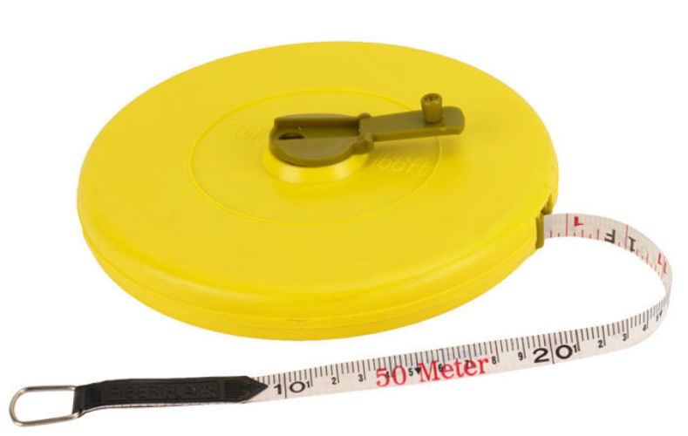
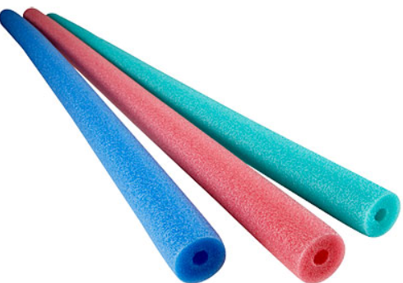
Things you need
Pool Noodles
Tape Measurer (50 m – it can be shorter. Our longest throws on a windy day were over 30 meters)
A place to throw – either outdoors or indoors

Slide 3
Have class select a parameter of interest
examples
Difference between throws With the Wind and Into the Wind
Difference between Overhand and Underhand Throws
Difference between Dominant and Non-Dominant Hand

Slide 4
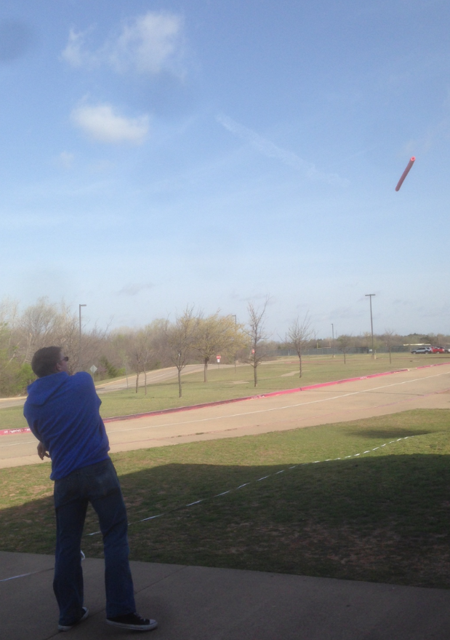
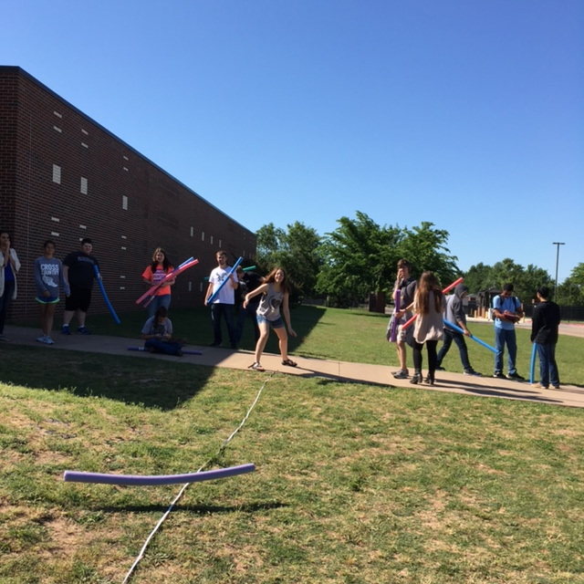

Slide 5
With the WIND | Into the WIND | Difference
33.5 | .65 | 32.85
4.5 | 3.35 | 1.15
18 | 10.5 | 7.5
27.5 | 3 | 24.5
27 | 4 | 23
13 | -13.5 | 26.5
26 | 6 | 20
20 | 4.5 | 15.5
22 | 8 | 14
20.5 | 10.5 | 10

Slide 6
Assumptions / Conditions
Paired Data : Each individual makes two types of throws
Independence : The throws of one individual should be independent of the others
Randomization : Each individual must randomly pick (ex. flipping a coin) to determine which throw to make first
Nearly Normal Condition : shown on next page

Slide 7
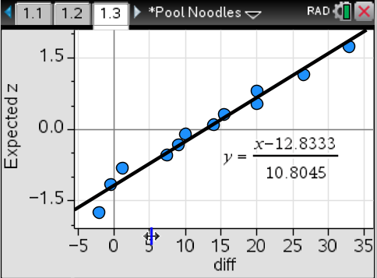
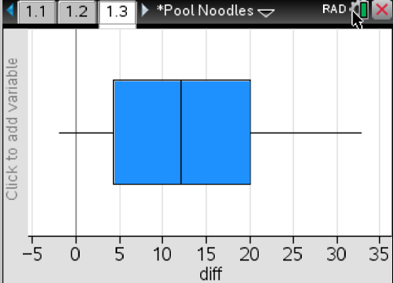
Nearly Normal Condition:
boxplot
Normal probability Plot

Slide 8
The calculations for a 95% confidence interval

Slide 9
