Slide 1
Growing Better Tree Diagrams
Doug Tyson
Central York HS
York, PA

Slide 2
Remember when I said …
“I used to be a math teacher, but now I’m a stats teacher and I don’t want to go back.”

Slide 3
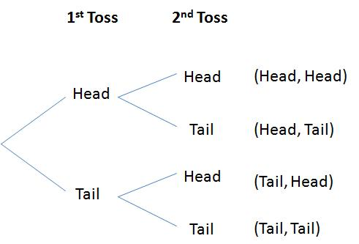
Now I’m saying…
“I can do all of those pesky compound probability questions with two-way tables, but I miss tree diagrams.”

Slide 4
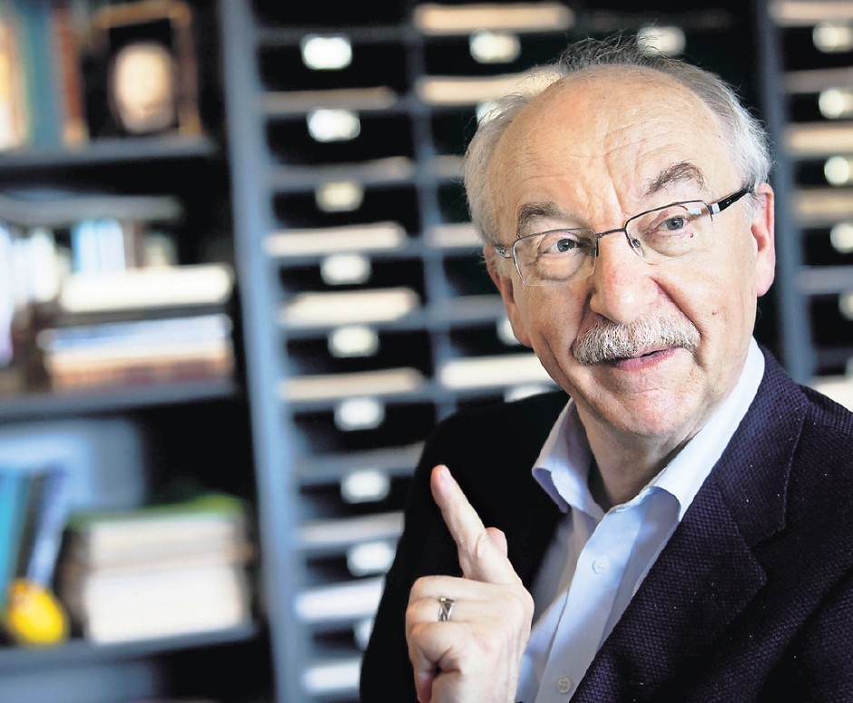
Why did I “switch” to tables?
Gurd Gigerenzer -> Daren Starnes -> Doug Tyson
Gurd on Risk Management (absolute risk vs. relative risk)

Slide 5
Tables seemed natural for counts…
Counts > Proportions
Kids don’t understand proportions!
100 tables or 10000 tables

Slide 6
Here’s one problem
Illegal music downloading has become a big problem: 29% of Internet users download music files, and 67% of downloaders say they don’t care if the music is copyrighted. Of those who don’t download music, 80% say they care about copyright.
(Adapted from The Practice of Statistics, 5th edition)

Slide 7
A two-way table for probabilities
 | DL Music | Doesn’t DL Music | TOTALS
Doesn’t Care About Copyright | 0.1943 | 0.1420 | 0.3363
Cares About Copyright | 0.0957 | 0.5680 | 0.6637
TOTALS | 0.29 | 0.71 | 1.00

Slide 8
A two-way table for 10000 internet users
 | DL Music | Doesn’t DL Music | TOTALS
Doesn’t Care About Copyright | 1943 | 1420 | 3363
Cares About Copyright | 957 | 5680 | 6637
TOTALS | 2900 | 7100 | 10000

Slide 9
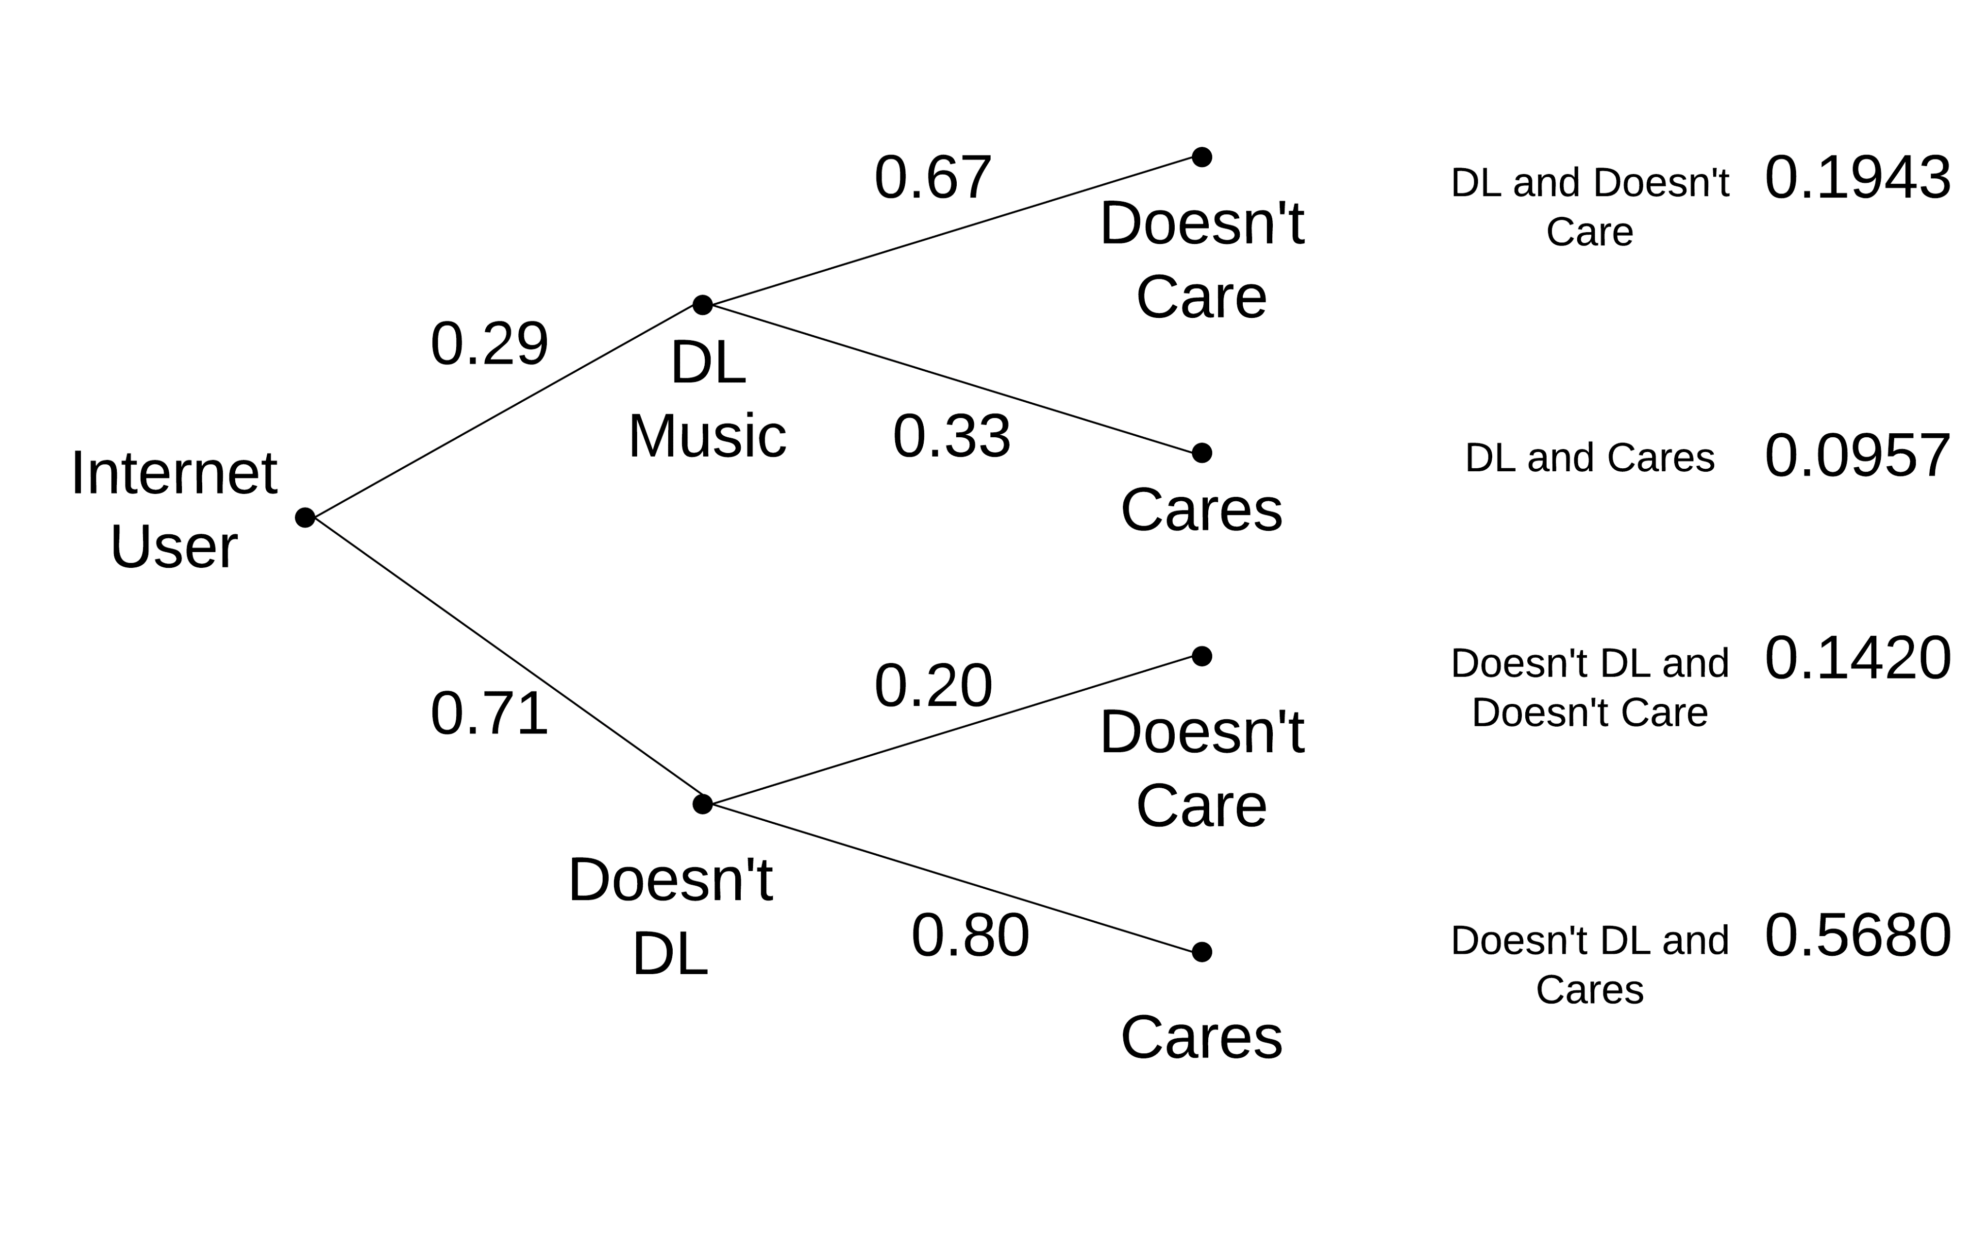
A tree diagram for probabilities

Slide 10
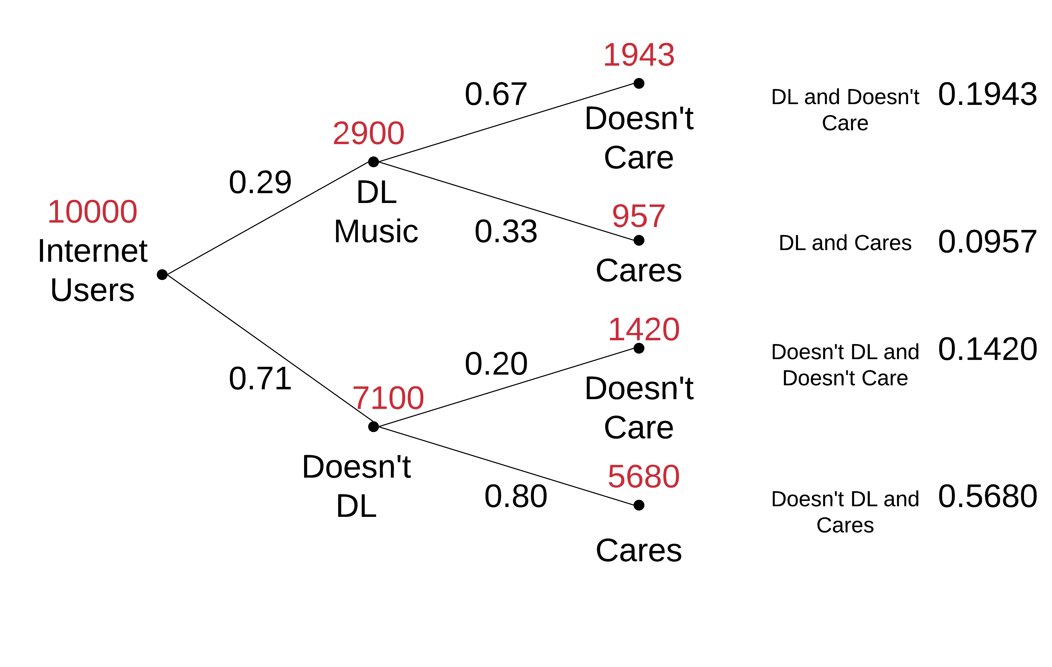
A tree diagram for 10000 Internet users

Slide 11
Grow better tree diagrams!
Add COUNTS to your tree diagrams!
Gmail: tyson.doug@gmail.com
FB: tyson.doug
Twitter: tyson_doug

