Slide 1
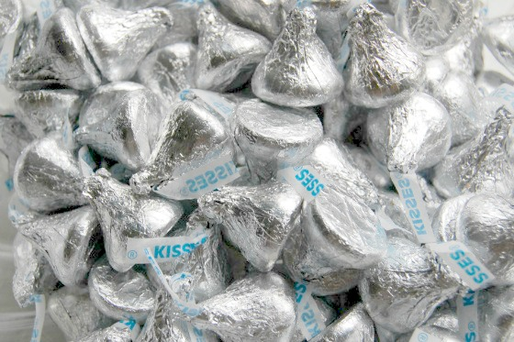
Gimme a Kiss!
Introducing Confidence Intervals
Using Hershey’s Kisses
Lisa Brock, West Forsyth High School
  lbrock@forsyth.k12.ga.us
Carol Sikes, South Forsyth High School
  csikes@forsyth.k12.ga.us

Slide 2
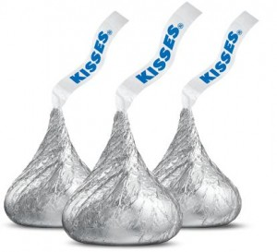
Credit
We found this activity on a website for Aaron Rendahl’s STAT 4102 activities at University of Minnesota. We made very minor modifications to it.
Materials & Time
Materials:
  Gimme a Kiss! Handout
  5 Hershey’s Kisses per student
  Small cup for each student
  Napkins
  Dot stickers
  Gridded chart paper
  Marker
Time: 45 minutes for Price is Right clip and Gimme a Kiss! Activity

Slide 3
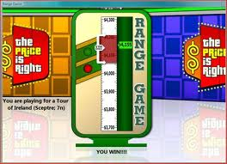
Before Kisses…Price is Right Clip
Credit for the idea of the Price is Right clip goes to Summer Abney, our fellow reader.
Find a clip of the Price Is Right Range Game on youtube.
  Let students watch the directions for the game. Pause video.
  Ask students what the strategy should be.
  Watch conclusion of clip. We like to use a clip in which the person wins but the green arrow is on the border of the range.
  https://www.youtube.com/watch?v=00a4pPyIwes

Slide 4
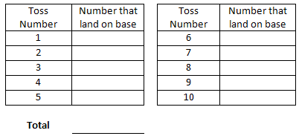
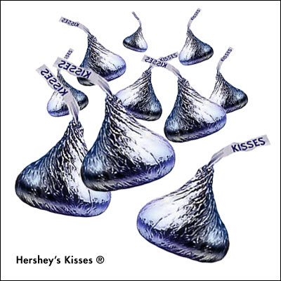

Data Collection
Introduction to problem: What proportion of the time will a Hershey’s Kiss land on its base?
Students drop their cup of 5 Kisses 10 times so that each student obtains a sample of 50 random Hershey’s Kiss drops.
Calculate p-hat and with their group members.

Slide 5
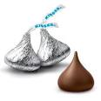
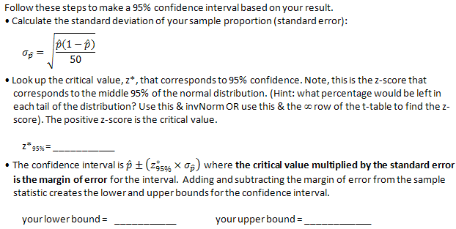
Calculation of Interval
Handout walks students through calculation of interval.

Slide 6
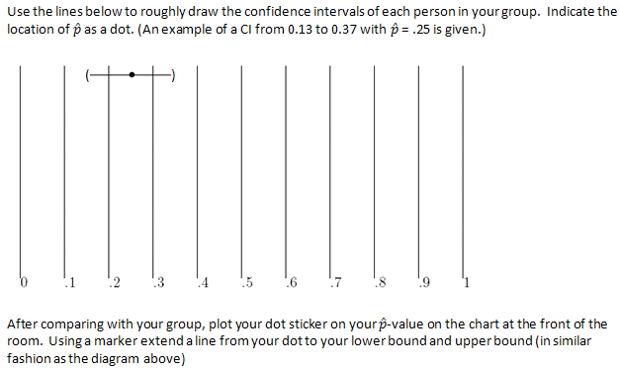

Graph of the Intervals

Slide 7
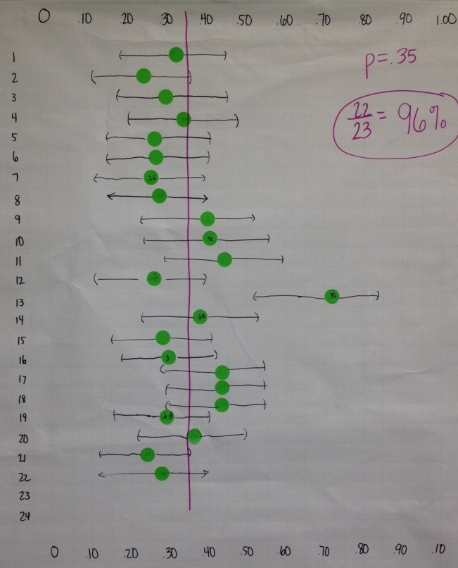
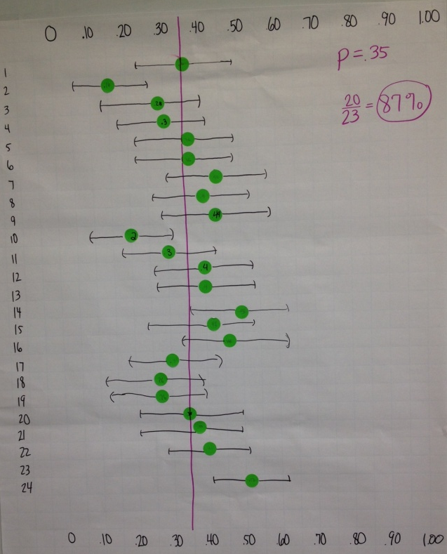
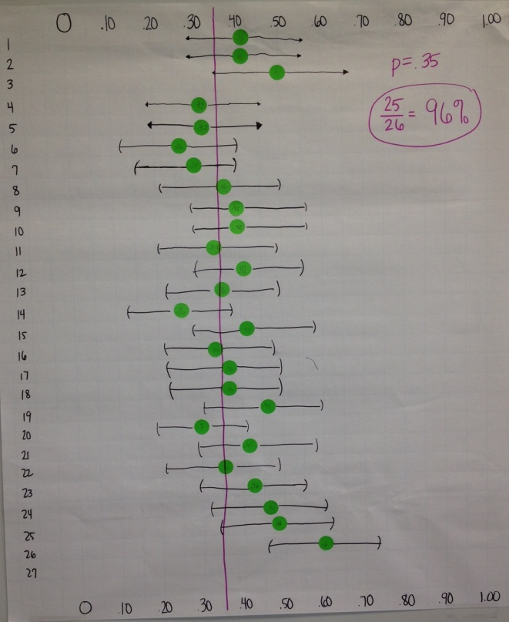

Pictures of Lisa’s 2014 Results
According to an NCTM article, the true proportion of the time a Hershey’s Kiss will land on its base is .35.

