Slide 1
How to Collect Data Quicker in Class
By Kirstie Doehler
Assistant Professor of Statistics

Slide 2
Outline
Part 1 - How I collect data quicker in class
Part 2 - Examples
A. Collecting data from class activities
B. Enhancing student reflection of academic performance
C. Performing Assessment
D. Gathering student feedback
Part 3 – Concluding Remarks

Slide 3
How I Collect Data Quicker in Class
Use Google Forms (GF)!
GF is part of Google Drive
Gmail account needed
Wikipedia says GF is: “a tool that allows you to collect information via personalized survey or quiz.”
Data collected is viewable in spreadsheet form and can be downloaded as a .xlsx file.

Slide 4
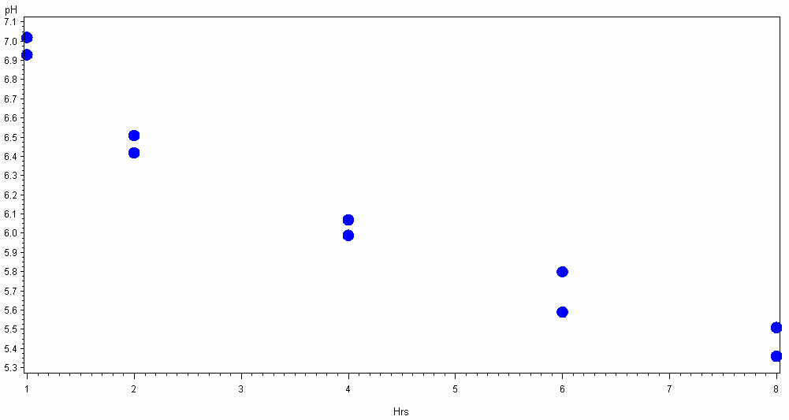
Class Activity – Example #1
Least Squares Regression Challenge
Students are asked to draw the “best” line on graph.
The (x,y) values of 2 coordinate points on their line are put into an Excel spreadsheet which is set up to tell them the equation of the line.
Students use a GF to enter the slope and intercept of their line.
The student whose line is “best” based on lowest SSE wins a prize.

Slide 5
Class Activity – Example #2
Age Discrimination? (Rossman & Chance)
This activity is an introduction to concepts of hypothesis testing.
3 of 10 workers loose their job from layoffs:
There is one card representing the age of each worker.
Cards shuffled & 3 cards are randomly chosen to represent the 3 laid off employees → Students find $\overline{x}$
Step 2 repeated 10 times
Students use a GF to enter the $\overline{x}$values

Slide 6
Enhancing Student Reflection
Students complete a Post-Exam Reflection via a GF
Some items on GF were:
1. Approximately how much time did you spend prepare for this exam?
2a. What percentage of your time was spent going over class notes?
3a. How many points did you loose due to careless mistakes?
4. Name at least 3 things you will do differently in preparing for the next exam.

Slide 7
Performing Assessment
25% of Final Exam was completed via GF
Questions on this part of the exam entailed:
A few True/False
A few multiple choice
Some short answer
Some longer explanation questions
Benefits of collecting partial exam data via GF:
You don’t really have to grade T/F or multiple choice questions
You can grade one entire question for the whole class at once (helps with fair grading)

Slide 8
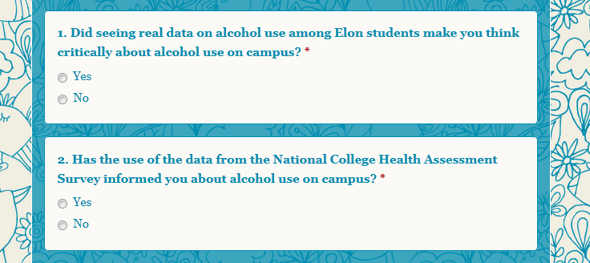
Gather Student Feedback – Example #1
Feedback on Alcohol Infusion Module

Slide 9
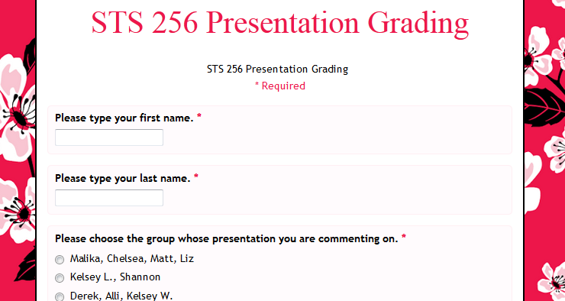
Gather Student Feedback – Example #2
Students give each other feedback on Presentations

Slide 10
Concluding Remarks
Collecting data using GF offers quick data collection
Students don’t have to come to the board or to instructor’s computer
Allows data to be collected digitally
Google Forms are easy to make
No $ needed
No computer lab? → No problem!
Note: Other survey software besides GF could also work very well ☺

