Slide 1
How np≥10 Became no problem For My Classes!
AP STATISTICS BEST PRATICES NIGHT, 2016
BOB LOCHEL, HATBORO-HORSHAM HIGH SCHOOL, PA

Slide 2
WORKING 24/7/365 TO RID OF THE WORLD OF “BALD” ANSWERS!

Slide 3
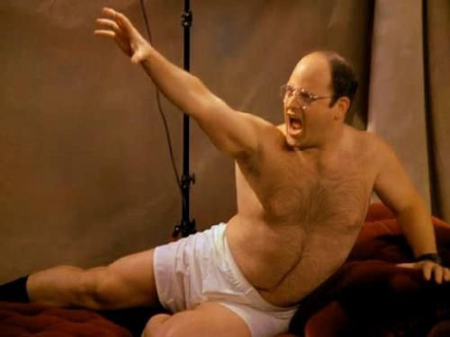
THE IMPOSSIBLE DREAM? RID THE AP STATS WORLD OF “NAKED” CONDITIONS!

Slide 4
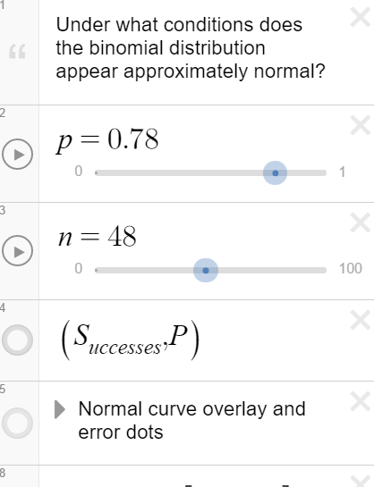
END OF BINOMIAL UNIT… DESMOS TO THE RESCUE!

Slide 5
LET’S CROWDSOURCE THIS PUPPY!
Name 2 n,p pairs which lead to an approximately normal shape.
Name 2 n,p pairs which lead to a shape which is clearly NOT approximately normal.
Name 2 n,p pairs which seem to be on the cusp of normality.

Slide 6
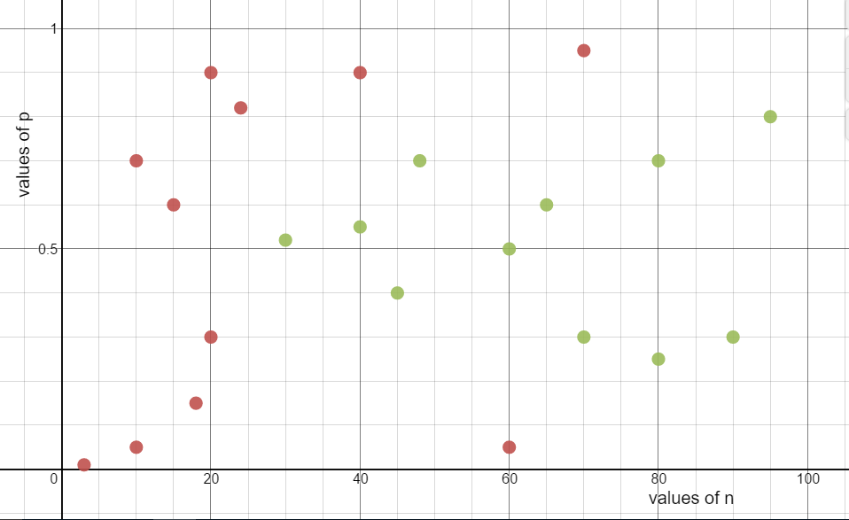
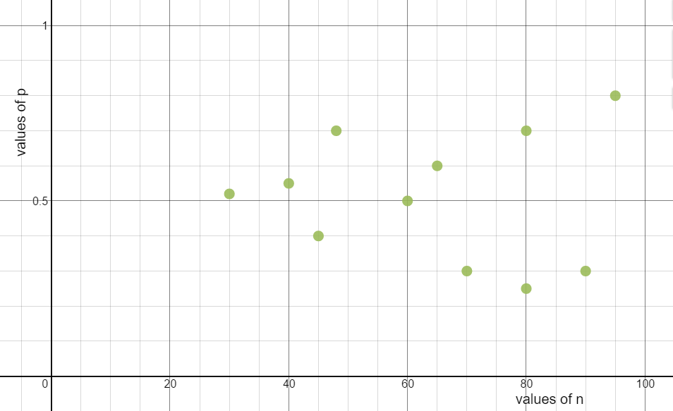
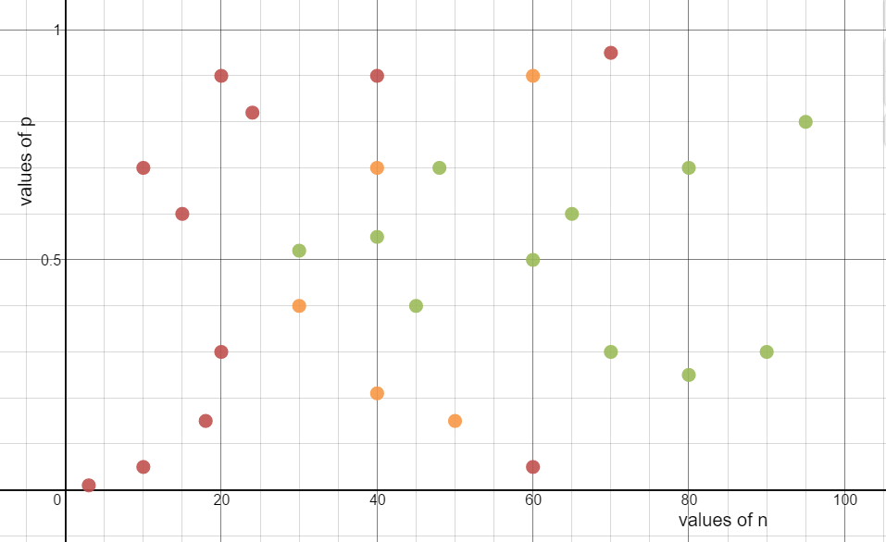
JOLLY RANCHERS + TEENAGERS = DATA ENTRY SPECIALISTS
What do we notice? What do we wonder?

Slide 7
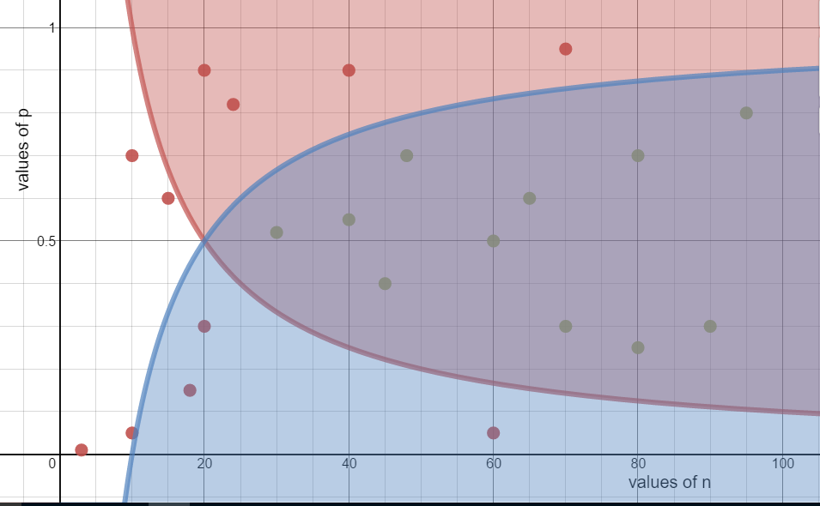
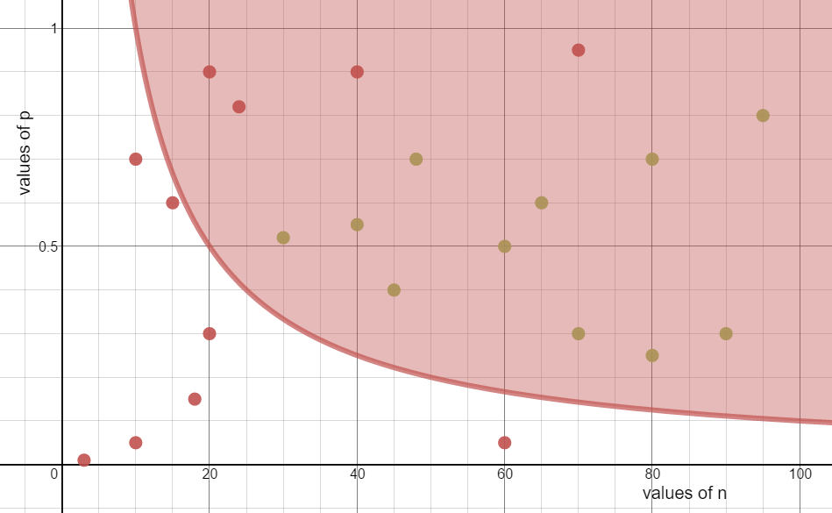
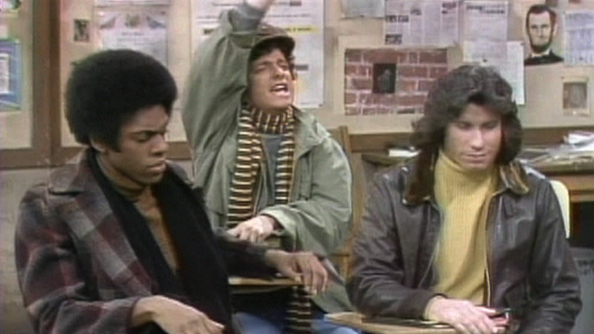
WILL THEY MAKE THE CONNECTION?
np>10!!!!

Slide 9
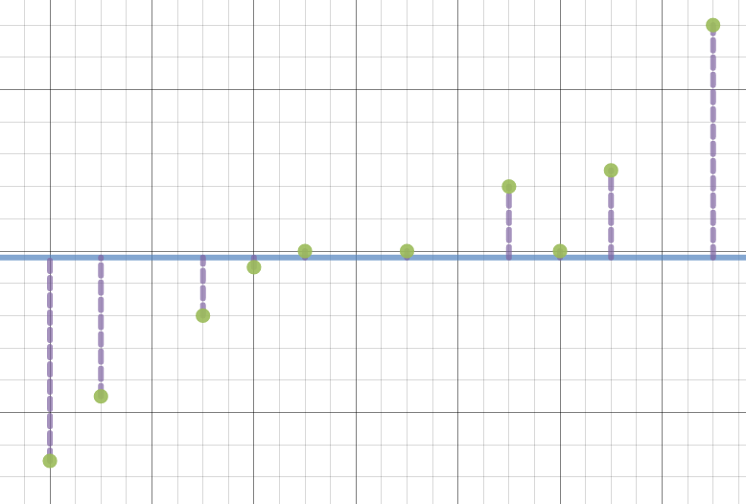
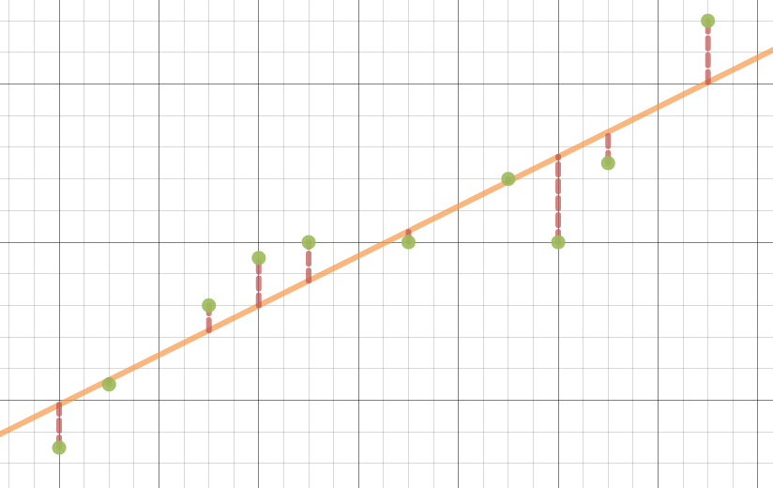
MORE DESMOS STATS AWESOMENESS!
That pesky r-squared thing
The mean-mean point
Mathcoachblog.com
Meet me in the social lounge later for Des-chat!

