Slide 1
LazerQuest ? YES!

Slide 2
What is Lazer Quest?
Hi-tech tag using lasers.

Slide 3
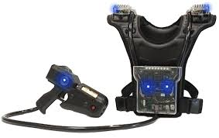
The Equipment

Slide 4
Light and Optics
The law of reflection, angle of reflection and point of incidence
The law of refraction and angle of refraction
The Visible Spectrum, including dispersion, the electromagnetic spectrum and the colors of white light

Slide 5
Why Lazer Quest ?
To generate “messy data” – unpredictable data whose analysis is not immediately obvious. (not the standard textbook fare).
Team building: AP Stats is often a first AP course for many students. They need to learn to trust each other, to ask questions in class, and to learn how to form study group.

Slide 6
But… Where’s the stats?

Slide 7
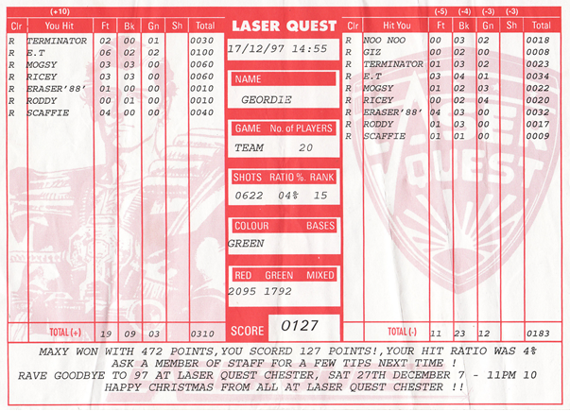
The Data Sheet

Slide 8
The Real Purpose
Collect “messy” data to analyze in multiple ways.
Learn to formulate a statistical question.
Learn how to use Minitab to compare distributions.
Present findings to peers within a specific time limit.
Create visual display of analysis that is correct and easy to understand.
Have fun and make the rest of the school jealous.

Slide 9
The Devil’s in the Details
Play two games of lazer tag.
Enter all the data from each game in the Google form (link on edmodo).
Choose a partner – you MUST work in teams.
Use Minitab to analyze and two questions.
Create a poster (tagboard provided) that presents your results clearly.
Create a 3-5 minute presentation of your results.

Slide 10
Sample Questions
Univariate
Are boys better players?
Do tall players score better?
Which sensor gets more hits?
Bivariate
Can you predict the score of game 2 from game 1?
Association between rank and ratio percent?
Association between shoulder hits and front hits?

Slide 11
Grading Rubric

Slide 12
Univariate
Question #1 (Univariate) 30 pts
at least two different types of graphs to compare data sets
summary statistics displayed for each data set
SOCS - comparative wording; refer to graphs and stats

Slide 13
Bivariate
Question #2 (Bivariate) 40 pts
scatterplot shows line of best fit
residual plot
regression analysis included
description of scatterplot
interpretation of slope, r, r²

Slide 14
Rest of the points
Presentation 10 pts
stays within time limit
makes eye contact; speaks clearly and at moderate rate
engages the audience
Poster display 10 pts
has a title and states question clearly
presents results clearly
neat and organized; uses color judiciously
Enter data into Google form by deadline 10 pts

Slide 15
Coincidence?
This year I had 48 kids in two sections.
Next year – 110 signed up

