Slide 1
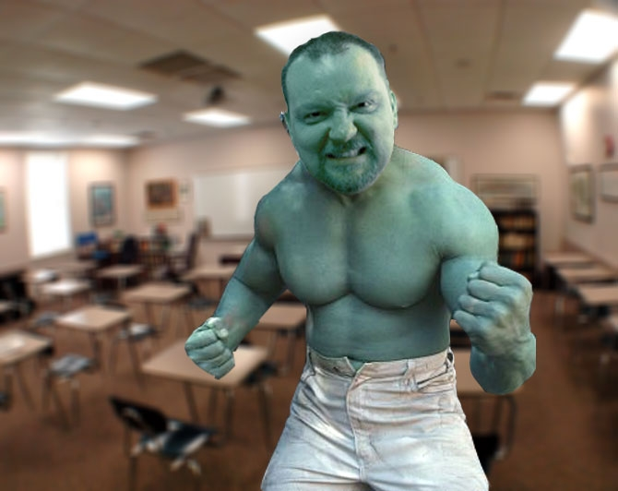
Visual Aids in AP Statistics
Darin Clifft
Memphis University School
not

Slide 2
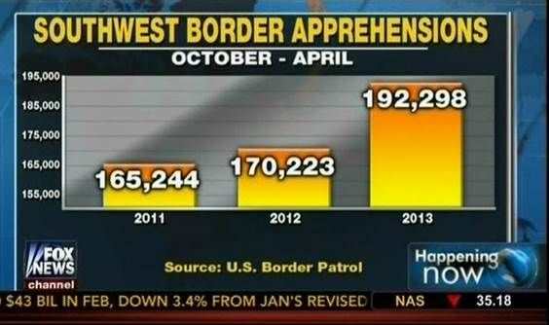
Fox news – don’t truncate y-axis
Notes:
MUS is heavily Republican. Fox News is popular. Bad graph- y-axis is truncated. Exaggerates differences in bars to make it seem that there has been a tremendous rise in the number of Mexicans crossing the border.

Slide 3
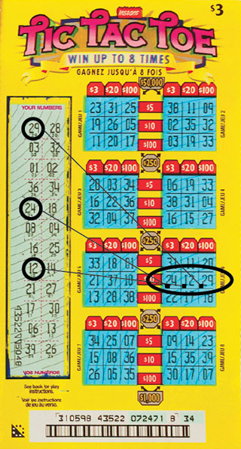
Mohan Srivastava cracks the Canadian Tic-Tac-Toe scratch lottery game, 2003
Source: Wired Magazine, January 2011
Notes:
Gambling is always interesting to my students. Randomization- scratch off numbers are not randomized. Dr. Srivastava figured out winning tickets have numbers that occur only once and in a row/ column.

Slide 4
Michael Larson wins big at Press Your Luck, 1984
https://youtu.be/bfOm7K8A0Pw
Michael watched hours of the show and found out that there were actually 5 patterns in the light indicator. He memorized them all and determined that positions 4 and 8 never had a Whammy.
What did CBS do?
Paid the guy off and bought new software that used 32 patterns and eliminated the possibility of memorizing the patterns.
Notes:
Kids love the story of this lazy bum who used get-rich-quick-schemes to make money and hit it big with this game show.

Slide 5
Hudson Anthony wins big at Hutchison Volleyball Raffle, September 2015
Hudson won 3 of 4 raffle prizes
Bought tickets late that were thrown on top of the pile
Bucket wasn’t shaken
Bought more tickets before each quarter-drawing and threw them on top of the pile
Notes:
This story of one of their peers and the school next door always grabs their attention. I mention about this preacher’s kid using what I have taught him for evil.

Slide 6
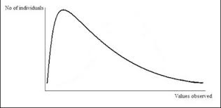
A student - outliers
Thompson English Test
Morrison
Notes:
Thompson is a very difficult English teacher that all students know and loathe. I pick a smart kid and ask what his grade does to the curve/ average. They all know what a “curve-breaker” is.

Slide 7
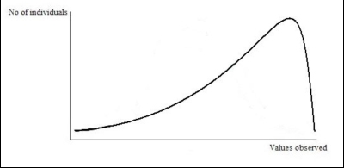
A student - outliers
AP Government Test
Threlkeld
Notes:
AP Government is a VERY easy class at my school. I ask about a student from a lower grade taking it. They all know what his lame score does to the average.

Slide 8
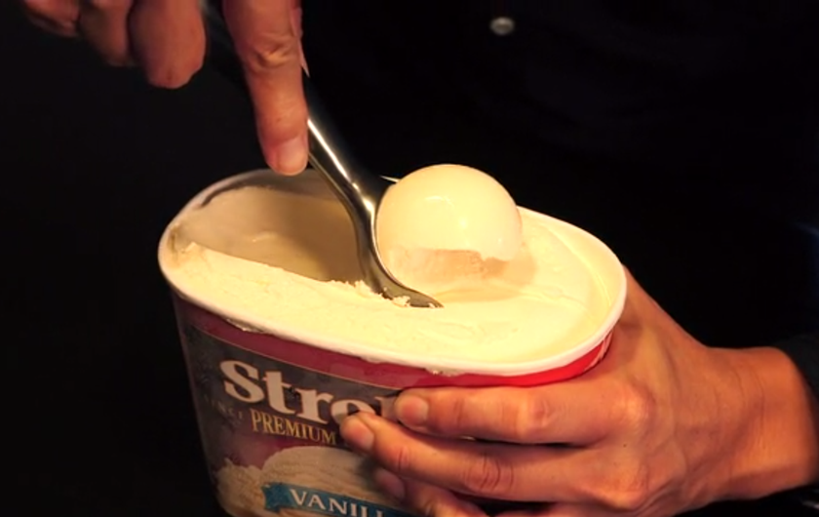
Scooping ice cream – subtracting random variables
Notes:
Bring in a punch bowl and a cup or bring in ice cream to share with the kids. Talk about the variability of ice cream in the tub. Talk about the variability in the tub once you’ve taken out a scoop. Are you more sure or less sure of the amount left? Subtracting variables does not subtract variation but adds it.

Slide 9
Soup- size of sample, not proportion
Notes:
Bring in a big pot from the school kitchen, a crockpot, and a soup bowl. How much of do you need to try to make sure it tastes good?... Not “half” or a “quarter”- that would be too much from the big pot. Just take a “large” sample- a big spoonful. Also, talk about making sure you stir the soup to “randomize;” you want to make sure you get the veggies off the bottom and not just the liquid on the top.

Slide 10
Arms spread wide- confidence interval interpretation
Notes:
Bring in the principal/vice principal/etc. Have them stand in the front of the room. Place students around him. Have him reach out to grab students- 95% of the samples should fall within 2 standard deviations of the mean. Then have the students reach out to grab the principal- 95% of all sample mean intervals should grab the population mean. Thinking about moving them to the football field, blindfolding them and having them “tackle” the principal. Since all students have been trained to tackle in the same manner, 95% should be able to do it correctly – 95% of all sample mean intervals should contain the population mean. Add yardsticks to each hand and talk about how confident you are to “tackle” the principal- goes up to 99% or more.

Slide 11
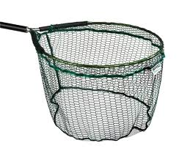
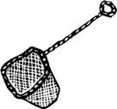
Fishing nets - confidence level and interval size comparison
Which one are you more confident you’ll catch fish with?
More confidence=
larger interval
less confidence=
smaller interval
Notes:
Bring in fishing nets to illustrate relationship between interval size and confidence.

Slide 12
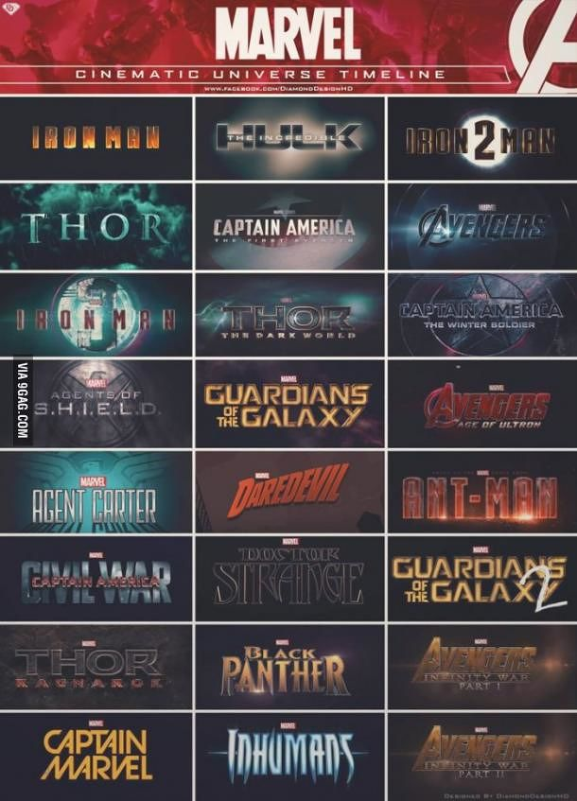
H_{o}: Marvel movies are successful blockbusters – can’t “accept” the null hypothesis
Notes:
Can you “prove” that Marvel movies are all successful blockbusters? No. All of these are successful blockbusters. If Dr Strange is a successful blockbuster does that “prove” that Marvel movies are all successful blockbusters? No. If Black Panther or Inhumans or Captain Marvel are all successful blockbusters does that “prove” that Marvel movies are all successful blockbusters? No. One Great Lakes Avengers flop and my null hypothesis is wrong. They would ALL have to be successful blockbusters to prove that’s true; can’t prove it, can’t “accept” it. We are waiting on the time when we might find ONE COUNTEREXAMPLE to disprove the null hypothesis.

Slide 13
Coats- no pattern in residuals is more important than high r²
Which one can I wear to Chapel?
-not appropriate
-doesn’t fit well
-appropriate
-doesn’t fit well
-not appropriate
-fits well
-appropriate
-fits well
Notes:
What determines “best linear fit”? High r² or no pattern in the residual plot? No pattern in the residual plot!- which means that no other model besides linear is appropriate. The first and third are out because they are not appropriate for Chapel and the first one is terrible because it’s not appropriate and doesn’t fit. The Hulk hoodie fits perfect but it’s not appropriate for Chapel and will get me an early school- there’s something better.

Slide 14
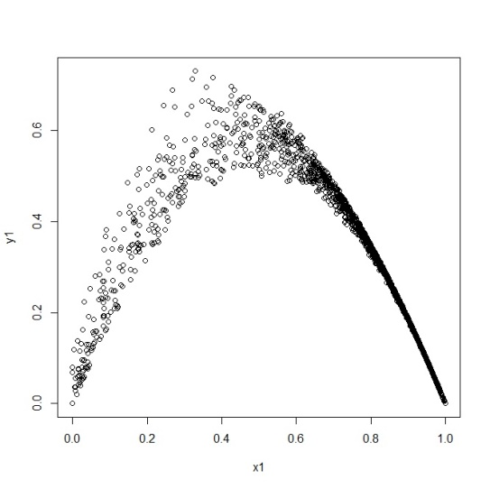
Is the line a good fit?
Not appropriate.
Pattern in the
residual plot.
NO
Doesn’t fit.
R² too small
Notes:
Lady Gaga. Not appropriate for Spring Formal/ Prom and doesn’t really fit.

Slide 15
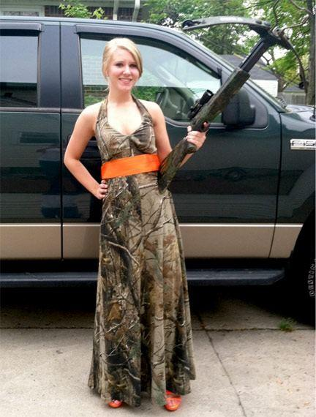
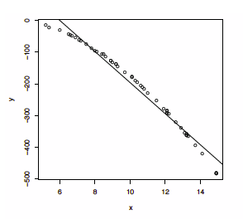
Is the line a good fit?
Not appropriate.
Pattern in the
residual plot.
NO
Fits.
R² is large
Notes:
Fits well but is not an appropriate Spring Formal/ Prom dress.

Slide 16
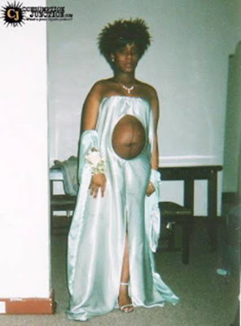
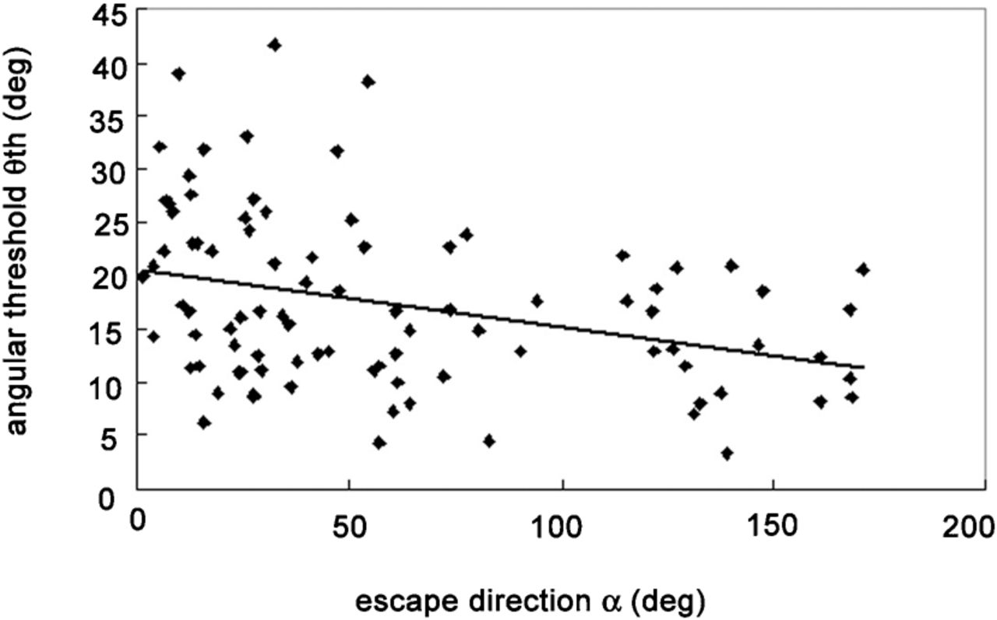
Is the line a good fit?
Appropriate.
No pattern in the
residual plot.
NO
Doesn’t fit.
R² is too small
Notes:
Is appropriate Spring Formal. Prom dress but doesn’t fit well.

Slide 17
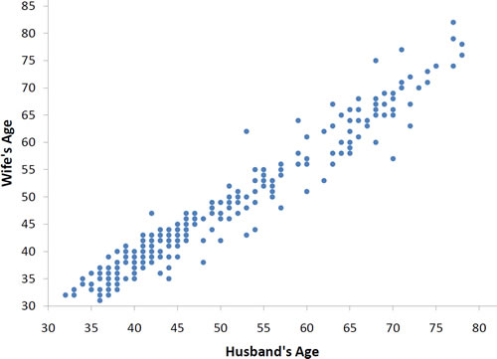
Is the line a good fit?
Appropriate.
No pattern in the
residual plot.
YES
Fits.
R² is high

