Slide 1
Crowdsource Your Review AP Statistics Reading 2016 Best Practices Night Leigh Nataro
Moravian Academy lnataro@mamail.net
@mathteacher24

Slide 2
Crowdsourcing: Process of Getting
Work from a Crowd of People

Slide 3
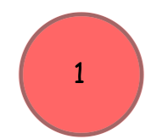
Company has a problem.
Mrs. Nataro has a problem.
Many students are absent on days leading up to the exam.

Slide 4
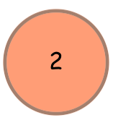
Company broadcasts the problem online.
Mrs. Nataro broadcasts some problems online via google docs.

Slide 5
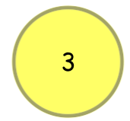
The online “crowd” submits solutions.
Mrs. Nataro’s students type their ideas and solutions in the google doc.

Slide 6
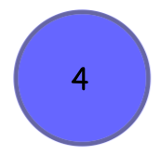
The crowd and company vet solutions jointly.
The students and Mrs. Nataro edit and critique within the doc.

Slide 7
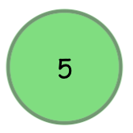
Company rewards winning solvers.
Mrs. Nataro publically thanks those with good ideas.

Slide 8
Company and community profits.
Students get great scores and return at Homecoming with stories of how glad they were they took AP Stat!

Slide 9
Create the doc and share
Assign problems to pairs
Change focus daily –
key concept, pick a wrong one,
explain the right one
Let the crowd have its way
(Draftback add-on)
But make comments when needed

Slide 10
Crowdsource Your Review AP Statistics Reading 2016 Best Practices Night Leigh Nataro
Moravian Academy lnataro@mamail.net
@mathteacher24

