Slide 1
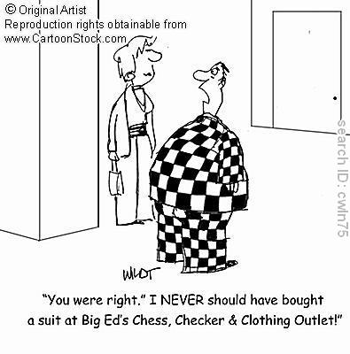
ap statistics
FRAPPY! 8

Slide 2
ideal solution part a
P(neck size < 14 or neck size 18)
= P(neck size < 14 ) + P(neck size 18)
= 0.00758 + 0.00051
= 0.00809

Slide 3
scoring part a
Essentially correct (E) if the response
1. recognizes the need to look at neck sizes below 14 or above 18
2. correctly computes the two tail probability(except for minor arithmetic or transcription errors) and adds those probabilities.

Slide 4
scoring part a… cont’d
Partially correct (P) if the response
Considers neck sizes only below 14 (or above 18) and correctly computes this probability
Recognizes the need to look at neck sizes below 14 and above 18 but does not compute both tail probabilities correctly
Recognizes the need to look at neck sizes below 14 and above 18 but approximates using the Empirical Rule
Computes the proportion of customers that will find the store carries their size
States the correct answer (0.0081) without supporting work

Slide 5
part b ideal solution

Slide 6
scoring part b
Essentially correct (E) if
1) the appropriate probability is illustrated using a normal curve in which the endpoints are identified and the mean and standard deviation are implied
2) the required probability is correctly computed (except for minor arithmetic errors)
Partially correct (P) if only one of the previous elements is correct.

Slide 7
ideal solution part c
X = number of customers who request size M
X is binomial with n = 12 and p = 0.5072
P(X = 4) = ₁₂ C ₄ (0.5072)⁴ (0.4928)⁸
= 495(0.0662)(0.0035)
= 0.1139

Slide 8
scoring part c
Essentially correct (E) if
1. the student recognized the setting as binomial
2. the probability calculated in part b is used for p
3. work is shown – that is, the correct values for n and x are given and the desired probability calculated, or the binomial formula is correctly evaluated

Slide 9
scoring part c… cont’d
Partially correct (P) if
The student recognizes the situation as binomial and identifies p from part b but does not compute the desired probability
The student gives the correct probability 0.1139 but work is not shown
NOTE: rounding the probability from part b is acceptable for part c

Slide 10
tally time!
4 Complete Response: EEE
3 = Substantial Response: EEP
2 = Developing Response: EEI EPP PPP
1 = Minimal Response: EPI EII PPI
0 = Insufficient Response: PPI PII III

